Slide 1
Working with The Forms

Slide 2
Forms
HTML forms provide a way to send substantial data from the user to the server where it can be processed.
Forms work in a two-step process.
The form must be presented to the user. He then enters information and submits the form.
Every form has a target for what page to load that will process the data when the user submits. processed.

Slide 3
Building a Form
Every form must have these basic components:
The submission type defined with the method keyword
GET : will be displayed at url.
POST : will not be displayed at url.
One or more input elements defined with the input tag.
The destination to go to when submitted defined with the action keyword.

Slide 4
Building a Form
<form action="<?php echo htmlspecialchars($_SERVER["PHP_SELF"]);?>" method="POST" autocomplete="on">
Name :
<input type="text" name="name" size="30" maxlength="50" placeholder="Name (max 50 characters)" required autofocus>
<br />
<input type="submit" name="save" value="Submit">
</form>

Slide 5
$_SERVER["PHP_SELF"]
The $_SERVER["PHP_SELF"] is a super global variable that returns the filename of the currently executing script.
So, the $_SERVER["PHP_SELF"] sends the submitted form data to the page itself, instead of jumping to a different page.
This way, the user will get error messages on the same page as the form.

Slide 6
htmlspecialchars()
The htmlspecialchars() function converts special characters to HTML entities. This means that it will replace HTML characters like < and > with &lt; and &gt;.
The predefined characters are:
& (ampersand) becomes &amp;
" (double quote) becomes &quot;
' (single quote) becomes &#039;
< (less than) becomes &lt;
> (greater than) becomes &gt;

Slide 7
htmlspecialchars()
Convert the predefined characters "<" (less than) and ">" (greater than) to HTML entities:
<?php $str = "This is some <b>bold</b> text."; echo htmlspecialchars($str); ?>
The browser output of the code above will be:
This is some <b>bold</b> text.
The HTML output of the code above will be (View Source):
<!DOCTYPE html> <html> <body> This is some &lt;b&gt;bold&lt;/b&gt; text. </body> </html>

Slide 8
Types of Input
Text boxes
Text areas
Checkboxes
Radio buttons
Hidden
Select (single & multiple)

Slide 9
Input Types
Input type : text
A text type element is used to capture these strings from the user.
The name attribute is required to process the input after a form submission as it specifies how to reference the value.
Ex:
<input type="text" name="name" size="30" maxlength="50" placeholder="Name (max 50 characters)" required autofocus>

Slide 10
Input Types
Input type : number
It is used for input fields that should contain a numeric value.
<input type="number" name="points" min="0" max="100" step="10" value="30">
Input type : range
It is used for input fields that should contain a value within a range.
<input type="range" name="points" min="0" max="10">

Slide 11
Input Types
Input type : email
It’s used for input fields that should contain an e-mail address.
It’s not supported in Safari browser.
<input type="email" name="email">
Input type : url
It’s used for input fields that should contain a URL address.
It’s not supported in Safari browser.
<input type="url" name="homepage">

Slide 12
Input – Text Area
Text area is used when you need a large chunk of text froma user.
Ex:
<textarea name="address" rows="5" cols="30" placeholder="Address (max 100 characters)" required></textarea>

Slide 13
Input - Checkboxes
A checkbox is useful when you want to give users several different options, especially when they’re allowed to select each choice individually.
Unlike the prior input types, checkbox returns an array.
Ex:
<input type="checkbox" name="hobby[]" value="travelling">Travelling<br>
<input type="checkbox" name="hobby[]" value="reading">Reading<br>
<input type="checkbox" name="hobby[]" value="swimming">Swimming<br>
<input type="checkbox" name="hobby[]" value="painting">Painting<br>

Slide 14
Input - Radio buttons
Radio buttons are like checkboxes except you can select only one radio button at a time.
All of the radio buttons in a group must use the same name, and only one value can be selected.
Ex:
<input type="radio" name="gender" value="male">Male <br />
<input type="radio" name="gender" value="female">Female

Slide 15
Input - Select
Selects present a list of options to the user.
You can specify whether a user can select only one or many items from the list (using multiple).
Ex:
<select name="city" required>
<option>--Select a city--</option>
<option value="airport_west">Airport West</option>
<option value="box_hill">Box Hill</option>
<option value="yarraville">Yarraville</option>
</select>

Slide 16
Input - Select
Example of select that allow multiple choice:
<select name="city[]" required multiple="multiple">
<option>--Select a city--</option>
<option value="airport_west">Airport West</option>
<option value="box_hill">Box Hill</option>
<option value="yarraville">Yarraville</option>
</select>

Slide 17
Input - Hidden
Hidden form elements allow you to send information from the form to the script that processes the data without that information being visible to the user.
Hidden fields can be viewed via the Page Source View in most browsers.
Therefore, it’s not advisable to put passwords in a hidden field.
Ex:
<input type="hidden" name="submitted" value="true" />

Slide 18
Form Method
There are 2 types:
GET
POST
Both GET and POST are treated as supper global variable $_GET and $_POST.
$_GET and $_POST create an array which holds key/value pairs, where keys are the names of the form controls and values are the input data from the user.
Ex: array( key => value, key2 => value2, key3 => value3, ...)).

Slide 19
GET Method
$_GET is an array of variables passed to the current script via the URL parameters.
Information sent from a form with the GET method is visible to everyone.
GET also has limits on the amount of information to send (about 2000 characters).
It is possible to bookmark the page (because the variables are displayed in the URL).
GET may be used for sending non-sensitive data.
A form field value can be access by $_GET[field], ex: $_GET['name'];

Slide 20
POST Method
$_POST is an array of variables passed to the current script via the HTTP POST method.
Information sent from a form with the POST method is invisible to others (all names/values are embedded within the body of the HTTP request)
There is no limits on the amount of information to send.
Supports advanced functionality such as support for multi-part binary input while uploading files to server.
It is not possible to bookmark the page (because the variables are not displayed in the URL).
A form field value can be access by $_POST[field], ex: $_POST['name'];

Slide 21
Accessing Submitted Form Values
$_POST[field] is used to access a field when using the POST field submission.
$_GET[field] is used to access a field when using the GET field submission.
Ex:
$name = $_POST['name'];
$address = $_POST['address'];
$gender = $_POST['gender'];
$email = $_POST['email'];
$city = $_POST['city'];

Slide 22
Working with Multiple Values
Use array to catch multiple values, ex: from checkboxes or select.
$hobby= $_POST["hobby"];
if (!empty($hobby)){
echo "The hobbies selected are: ";
foreach($hobby as $hobby_item){
echo '<br />'.htmlentities($hobby_item);
}
}

Slide 23
Validating User Input

Slide 24
Validating User Input
Whenever you are taking data from a user, you should always validate it.
If you do not validate the user’s input, it can cause many problems—including possible security risks.
Form validation
Client side validation
Server side validation

Slide 25
Client-Side validation
Using some new input types and attributes in HTML 5
HTML input type : number, email, url, range, datetime, tel, etc.
The required attribute : specifies that an input field must be filled out before submitting the form.
The pattern attribute specifies a regular expression that the <input> element's value is checked against.
Limitation: Some of browser do not support those input types or attibutes.
Example: Safari browser doesn’t support required and pattern attributes.

Slide 26
Client-Side validation
Using Javascript
You can use javascript to check fields and alerting the user to a problem before the data is submitted to the server.
The validation can be as simple as checking for an empty field, or it can do more complex checks such as validating an email address (using regular expression).
Although JavaScript provides immediate feedback to a user if a field doesn’t pass validation, it shouldn’t be relied on as the only validation method.
Your PHP code should always perform the final validation.

Slide 27
Server-Side Validation
Using PHP code to validate user input data.
Stripe any whitespace that the user might have inadvertently entered at the input form by using trim() function.
Remove backslashes (\) from the user input data by using the PHP stripslashes() function.
Verify that the value is not empty.
Use htmlspecialchars() function to converts special characters to HTML entities.
Use regular expression (pattern matching) to build expressions that match strings.
Use filter_far function to validate and filter data coming from insecure sources, like user input.

Slide 28
trim()
trim()
Strip whitespace (or other characters) from the beginning and end of a string
Ex:
$text = "\t\tThese are a few words :) ... ";
echo trim($text);
Output:
These are a few words :) ...

Slide 29
stripslashes()
The stripslashes() function removes backslashes added by the addslashes() function.
This function can be used to clean up data retrieved from a database or from an HTML form.
Ex:
<?php echo stripslashes("Who\'s Peter Griffin?"); ?>
Output:
Who's Peter Griffin?

Slide 30
Check Empty Value
<?php
$name = test_input($_POST['name']);
if ($name == ''){
$error_name = "Name is required";
}
?>

Slide 31
isset() vs empty()
isset — Determine if a variable is set and is not NULL
It returns true only when the variable is not null.
empty — Determine whether a variable is empty
It returns FALSE if var exists and has a non-empty, non-zero value. Otherwise returns TRUE.
The following things are considered to be empty:
"" (an empty string)
0 (0 as an integer)
0.0 (0 as a float)
"0" (0 as a string)
NULL
FALSE
array() (an empty array)
$var; (a variable declared, but without a value)

Slide 32
isset() vs empty()
<?php $var = 0; // Evaluates to true because $var is empty if (empty($var)) { echo '$var is either 0, empty, or not set at all'; } // Evaluates as true because $var is set if (isset($var)) { echo '$var is set even though it is empty'; } ?>

Slide 33
is_null()
is_null — Finds whether a variable is NULL
It returns true only when the variable is null.
is_null() is opposite of isset(), except for one difference that isset() can be applied to unknown variables, but is_null() only to declared variables.

Slide 34
Regular Expression
Regular expressions allow you to perform searching tasks such as separating out a certain tag for an incoming text file or validating user input such as an email address.
Ex:
if (!preg_match("/^[a-zA-Z ]*$/",$name)) {
$error_name = "Only letters and white space allowed";
}

Slide 35
filter_var()
filter_var() function is used to validate and filter data coming from insecure sources, like user input.
filter_var() function filters a variable with the specified filter.
Ex:
if (!filter_var($email, FILTER_VALIDATE_EMAIL)) {
$error_email = "Invalid email format";
}

Slide 36
PHP Validate Filters
ID Name | Description
FILTER_VALIDATE_BOOLEAN | Return TRUE for "1", "true", "on" and "yes", FALSE for "0", "false", "off", "no", and "", NULL otherwise
FILTER_VALIDATE_EMAIL | Validate value as e-mail
FILTER_VALIDATE_FLOAT | Validate value as float
FILTER_VALIDATE_INT | Validate value as integer, optionally from the specified range
FILTER_VALIDATE_IP | Validate value as IP address, optionally only IPv4 or IPv6 or not from private or reserved ranges
FILTER_VALIDATE_REGEXP | Validate value against regexp, a Perl-compatible regular expression
FILTER_VALIDATE_URL | Validate value as URL, optionally with required components

Slide 37
Repopulating The Form
Modify the input form, fill the value attribute with the data inserted by user.
Ex:
Input type: text
$name = $_POST["name"];
<input type="text" name="name" size="30" maxlength="50" placeholder="Name (max 50 characters)" autofocus value="<?php echo $name;?>">

Slide 38
Repopulating The Form
Text area
$addres = $_POST["address"];
<textarea name="address" rows="5" cols="30">
<?php if(isset($address)) {echo $address;} ?>
</textarea>

Slide 39
Repopulating The Form
Radio button
$gender = $_POST["gender"];
<input type="radio" name="gender" value="male" <?php if (isset($gender) && $gender=="male") echo "checked";?>>Male <br />
<input type="radio" name="gender" value="female" <?php if (isset($gender) && $gender=="female") echo "checked";?>>Female

Slide 40
Repopulating The Form
Select
$city = $_POST["city"];
<select name="city" required>
<option value="airport_west" <?php if (isset($city) && $city=="airport_west") echo 'selected="true"';?>>Airport West</option>
<option value="box_hill" <?php if (isset($city) && $city=="box_hill") echo 'selected="true"';?>>Box Hill</option>
</select>

Slide 41
Repopulating The Form
Checkbox
$hobby = $_POST["hobby"]; //hobby is an array
<input type="checkbox" name="hobby[]" value="travelling" <?php if(isset($hobby) && in_array('travelling',$hobby)) echo 'checked'; ?>>Travelling<br />
<input type="checkbox" name="hobby[]" value="reading" <?php if(isset($hobby) && in_array('reading',$hobby)) echo 'checked'; ?>>Reading<br />

Slide 42
Insert Input Data into Database

Slide 43
Escape Input Data
Escapes special characters in a string for use in an SQL statement with mysqli_real_escape_string() function.
Sintax :
Procedural approach mysqli_real_escape_string(connection,escapestring);
OO approach
$connection->real_escape_string(escapestring);
Parameter | Description
connection | Required. Specifies the MySQL connection to use
escapestring | Required. The string to be escaped. Characters encoded are NUL (ASCII 0), \n, \r, \, ', ", and Control-Z.

Slide 44
Escape Input Data
$city = "Wall' Street";
$query = " INSERT INTO customers (name, address, city) VALUES('".$name."','".$address."','".$city."') ";
INSERT INTO customers (name, address, city) VALUES('John','Wall' Street','airport_west')
Could not query the database: You have an error in your SQL syntax; check the manual that corresponds to your MySQL server version for the right syntax to use near 'Street','airport_west')' at line 1

Slide 45
Escape Input Data
$city = "Wall' Street";
$city = $db->real_escape_string($city);
$query = " INSERT INTO customers (name, address, city) VALUES('".$name."','".$address."','".$city."') ";
Query: INSERT INTO customers (name, address, city) VALUES('John','Wall\' Street','airport_west')

Slide 46
Escape Input Data
Ex:
$name = mysqli_real_escape_string($db,$name);
$address = mysqli_real_escape_string($db,$address);
$city = mysqli_real_escape_string($db,$city);
OR
$name = $db->real_escape_string($name);
$address = $db->real_escape_string($address);
$city = $db->real_escape_string($city);

Slide 47
Add Data Using SQL Statement
$query = " INSERT INTO customers (name, address, city) VALUES('".$name."','".$address."','".$city."') ";
// Execute the query
$result = $db->query( $query );
if (!$result){
die ("Could not query the database: <br />". $db->error);
}else{
echo '1 record added. <br />';
}

Slide 48
Uploading Files

Slide 49
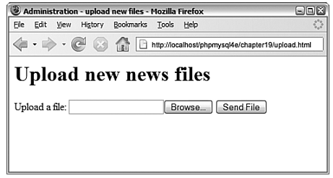
Uploading Files
One useful piece of PHP functionality is support for uploading files.
Usually, you implement this configuration with an HTML form interface.

Slide 50
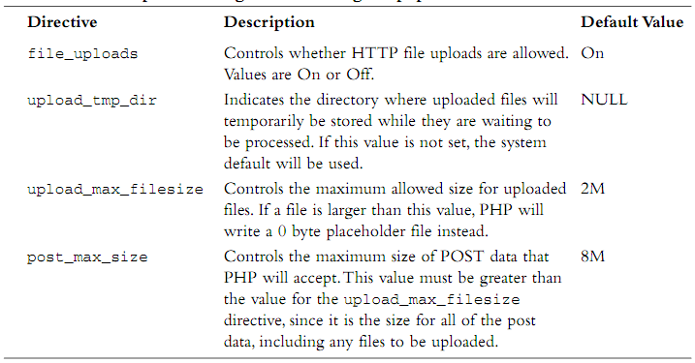
Directive Control for File Upload
php.ini file has five directives that control how PHP will work with file uploading.

Slide 51
Form Upload
<form action="upload.php" method="post" enctype="multipart/form-data"/>
<div>
File allowed : jpg, jpeg, png or gif<br /><br />
<input type="hidden" name="MAX_FILE_SIZE" value="1000000" />
<label for="userfile">Upload a file:</label>
<input type="file" name="userfile" id="userfile"/>
<input type="submit" value="Send File"/>
</div>

Slide 52
Form Upload
Note that this form uses POST. They do not work with GET.
In the <form> tag, you must set the attribute enctype=”multipart/form-data”.
You must have a form field that sets the maximum size file (in bytes) that can be uploaded. This is a hidden field and is shown here as
<input type=”hidden” name=”MAX_FILE_SIZE” value=” 1000000”>
Note that the MAX_FILE_SIZE form field is optional, as this value can also be set server-side.
You need an input of type file, shown here as <input type="file" name="userfile" id="userfile"/>

Slide 53
Upload Files
When the file is uploaded, it briefly goes into the temporary directory that is specified in your php.ini upload_tmp_dir directive.
If this directive is not set, it will default to the web server’s main temporary directory.
The data you need to handle in your PHP script is stored in the superglobal array $_FILES.
The entries in $_FILES will be stored with the name of the <file> tag from your HTML form.

Slide 54
Contents of $_FILES
For example, if your form element is named userfile, so the array will have the following contents:
$_FILES[‘userfile’][‘tmp_name’] → the place where the file has been temporarily stored on the web server.
$_FILES[‘userfile’][‘name’] → the file’s name on the user’s system.
$_FILES[‘userfile’][‘size’] → the size of the file in bytes.
$_FILES[‘userfile’][‘type’] → the MIME type of the file—for example, text/plain or image/gif.
$_FILES[‘userfile’][‘error’] → will give you any error codes associated with the file upload (add in PHP 4.2.0).

Slide 55
Types of Error
The possible constants and values of $_FILES[‘userfile’][‘error’] are as follows:
UPLOAD_ERROR_OK, value 0, means no error occurred.
UPLOAD_ERR_INI_SIZE, value 1, means that the size of the uploaded file exceeds the maximum value specified in your php.ini file with the upload_max_file- size directive.
UPLOAD_ERR_FORM_SIZE, value 2, means that the size of the uploaded file exceeds the maximum value specified in the HTML form in the MAX_FILE_SIZE element.

Slide 56
Types of Error (2)
UPLOAD_ERR_PARTIAL, value 3, means that the file was only partially uploaded.
UPLOAD_ERR_NO_FILE, value 4, means that no file was uploaded.
UPLOAD_ERR_NO_TMP_DIR, value 6, means that no temporary directory is specified in the php.ini (introduced in PHP 5.0.3).
UPLOAD_ERR_CANT_WRITE, value 7, means that writing the file to disk failed (introduced in PHP 5.1.0).

Slide 57
Processing File Upload
Check any error/ problem
Check if file already exists
Check file size
Check file type
If there is no problem, put the file where we'd like it.

Slide 58
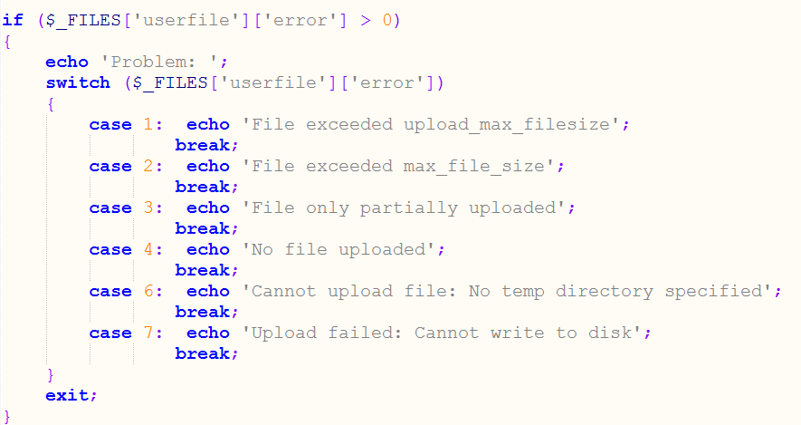
1. Check any error/ problem

Slide 59
2. Check if file already exists
$target_dir = "uploads/";
$target_file = $target_dir . basename($_FILES['userfile']['name']);
if (file_exists($target_file)) {
echo "Sorry, file already exists.<br />";
$upload_ok = 0;
}

Slide 60
3. Check file size
If you use hidden input ‘MAX_FILE_SIZE’, it has been done at step 1 (case 2).
If you don’t use it, check it by:
if ($_FILES['userfile']['size'] > 1000000) {
echo "Sorry, your file is too large.<br />";
$upload_ok = 0;
}

Slide 61
4. Check file type
Check file extension
$file_type = pathinfo($target_file,PATHINFO_EXTENSION);
$allowed_type = array("jpg", "png", "jpeg", "gif");
if(!in_array($file_type, $allowed_type)) {
echo "Sorry, only JPG, JPEG, PNG & GIF files are allowed.";
$upload_ok = 0;
}

Slide 62
4. Check file type (2)
Check MIME type
if ($_FILES['userfile']['type'] != 'text/plain'){
echo 'Problem: file is not plain text';
$uploadOk = 0;
}

Slide 63
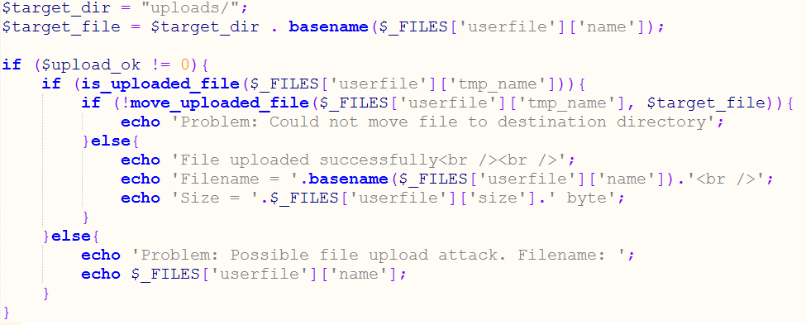
5. If there is no problem, put the file where we'd like it.

Slide 64
is_uploaded_file()
is_uploaded_file($_FILES['userfile']['tmp_name'])
It checks whether the specified file is uploaded via HTTP POST.
This function returns TRUE if the file is uploaded via HTTP POST.
For proper working, the function is_uploaded_file() needs an argument like
$_FILES['userfile']['tmp_name'] (the name of the uploaded file on the client's machine)
$_FILES['userfile']['name'] does not work.

Slide 65
move_uploaded_file()
move_uploaded_file($filename, $destination)
This function checks to ensure that the file designated by $filename is a valid upload file (meading that it was uploaded vias PHP’s HTTP POST upload mechanism).
If the file is valid, it will be moved to the filename given by $destination.

